Slide 1

Predicting the Probability of Bank Deposit Subscription
Submitted by :
Ahana Koshe : 336
Neha Mankani :340
Shafiya Sayyed :354
Shoieb Shaikh :357
DEPARTMENT OF COMPUTER ENGINEERING .
KEYSTONE SCHOOL OF ENGINEERING ,
Handewadi Chowk , Uruli Devachi , Shewalewadi
Pune, Maharashtra 412308

Slide 2
Table of Content
Introduction to the Domain
Introduction to Topic
Literature Survey
Tools and Technologies used
Data collection and cleaning
Machine Learning Models
Logistic Regression -Neha
SVC-Neha
KNN-Shafiya
Random Forest- Shafiya
Decision Tree - Ahana
Pruning on Decision Tree - Ahana
Implementation on Flask - Shoieb
Conclusion

Slide 3
Introduction to the Domain
Data is the new Oil
Machine Learning is a powerful concept and framework to make the best out of it.
Machine learning is a part of Artificial intelligence .
Machine learning is an interdisciplinary field .
What is the need for Machine Learning .

Slide 4
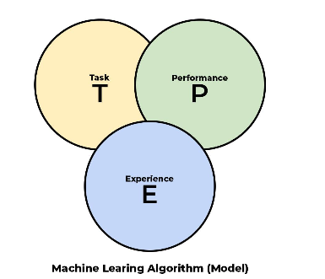
Need for Machine Learning :
We need machine learning to make data driven decision on a large scale .
To simply define machine learning :
It is a field that consist of algorithm that;
Improves their performance P
At executing some task T
Over the time with experience E
4.Then what is the difference between the Traditional Programming Paradigm and Machine Learning Paradigm

Slide 5
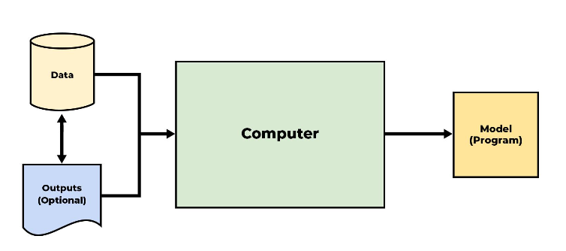
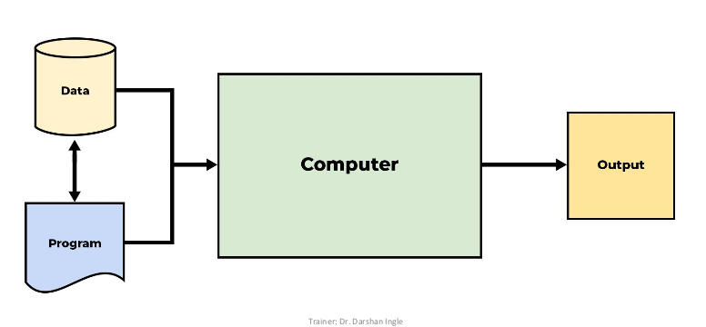
Difference between Traditional Programming and Machine Learning Paradigm
In machine learning paradigm we provide output of previously processed data/model to give and model as the out that can then be used to predict future based on the new based .
This is Traditional Programming paradigm that takes data and program as the input and gives and output after processing it .

Slide 6
Introduction to Topic
As the major application right now of Machine Learning is in the field of banking and finance .
So on those lines we choose our topic .
We have a dataset using which we will predict the probability of one person subscribing to term bank deposit .
Term deposits are basically what bank asks us to deposit a specific amount for a specific period of reserved time in the bank and the bank will provide return on the amount .
So we decided to take this topic and study on it to make an model that will tell the bank whom they can approach for a positive reply .

Slide 7
Literature Survey
The concept of term deposit in very dominant in the ever growing field of banking and finance but down the years approaching the mass and getting a few out of them has been a task that consumes time and reduces the productivity .
We decided to change this and design a model that could predict which customer can potentially subscribe so we can reduce time and increase productivity.
We on our research found a handful of research papers and upon looking into them we saw the models has low accuracy .
So we decided to take the dataset and use various algorithms on the dataset and make an model that is much better in the terms of accuracy ad could increase the productivity .

Slide 8
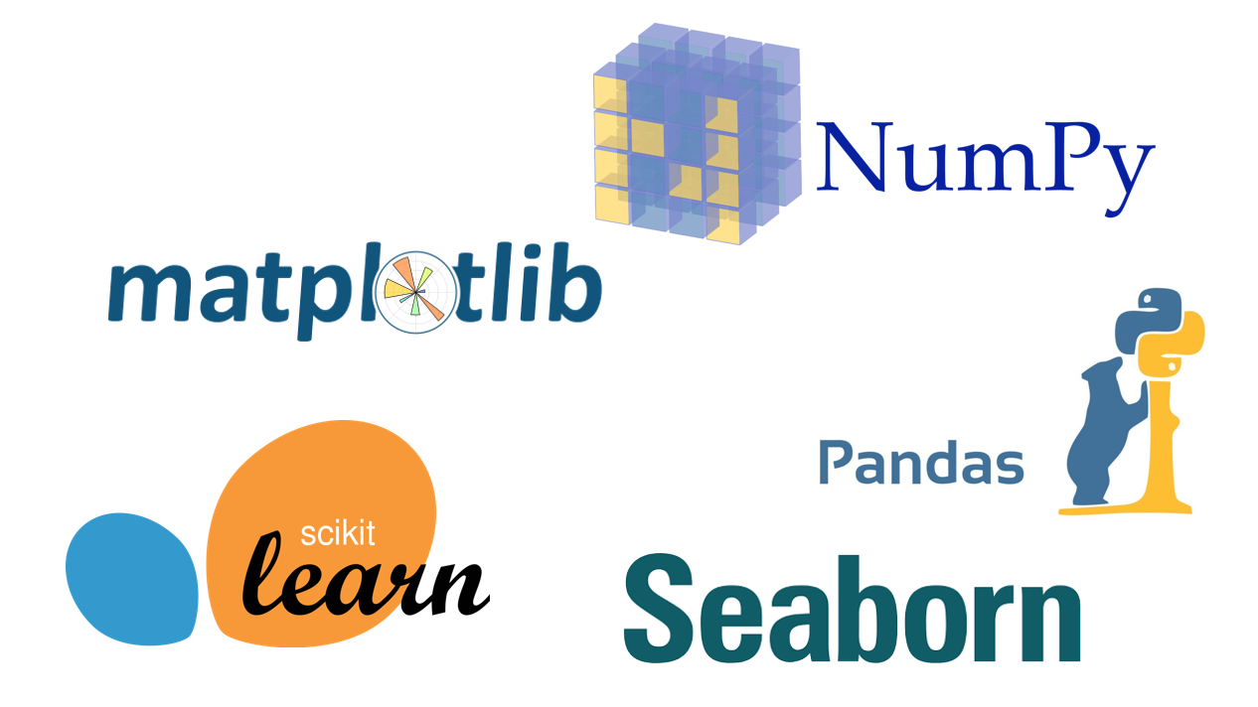

Tools and Technology used :

Slide 9
Data Collection and Cleaning
The original study uses data collected from a Portuguese bank for 17 direct marketing campaigns.
The purpose was to determine the effectiveness of direct marketing campaigns (DM) by observing whether a client decided to make a long-term bank deposit after receiving a DM phone call. [1] The original data set contained 17 explanatory variables and 45,211 rows. The response variable is ‘y’ and is categorical.
The data had many issues and errors .
We found a lot of outliers and after training a model with outliers we realised they had an major impact on the model and prediction .
So we made analysis and got important 7 factors that have major impact on the training of the model .
We replaced the outliers with the mean values in the column .
After that we had a perfect dataset of 45,191 rows and 9 columns .
For better working of the data we converted categorical data to numerical data .

Slide 10
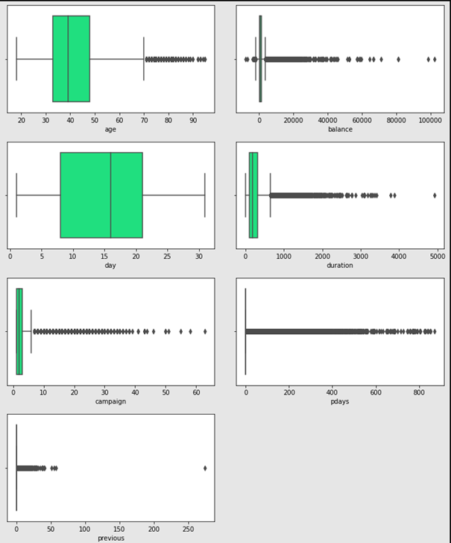
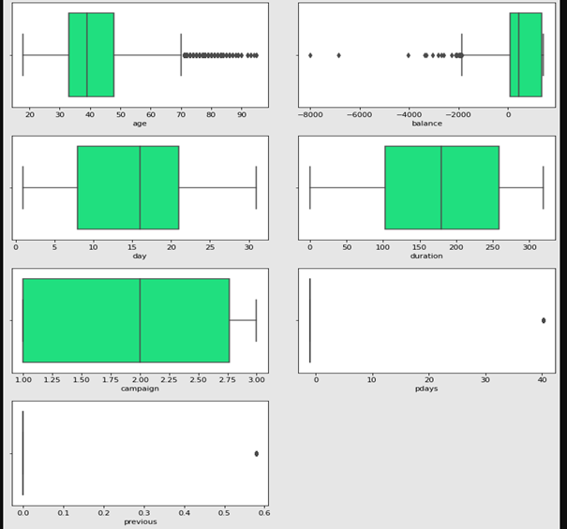
Removing outliers (Before and after )

Slide 11
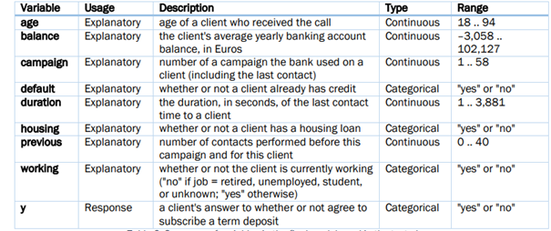
We determined these important columns from the dataset .

Slide 12
Training Machine Learning Models
Based on the cleaned data we tried out many machine learning models to get more accuracy .
Next we have some models that gave us good accuracy and we finally choose one of it for out model

Slide 13
LOGISTIC REGRESSION:
It is a technique borrowed by machine learning from the field of statistics.
Logistic function is a statistical model that uses Logistic function to model the conditional probability.
The probability will always range between 0 and 1.
The Logistic function, also called the Sigmoid function is an S shaped curve that can take any real-valued number and map it into a value between 0 and 1,but never exactly at those limits.

Slide 14
EXAMPLE:
To find if a person will default their credit card payment or not. The probability of a person defaulting their credit card payment can be based on the pending credit card balance and income etc.
Hence, we can write P(default=Yes|Balance)
When the P(default=Yes)>=0.5, then person will default their payment.
When the P(default=Yes)<0.4, then the person will NOT default their payment.
P(default=Yes|Balance)+P(default=No|Balance)=1

Slide 15
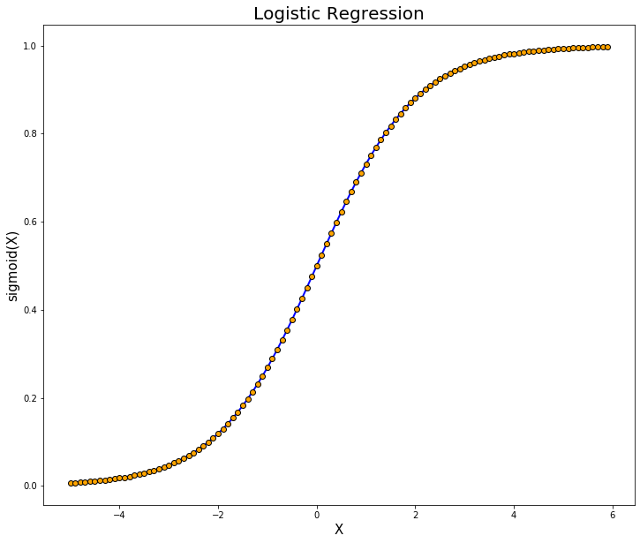
GRAPH:

Slide 16
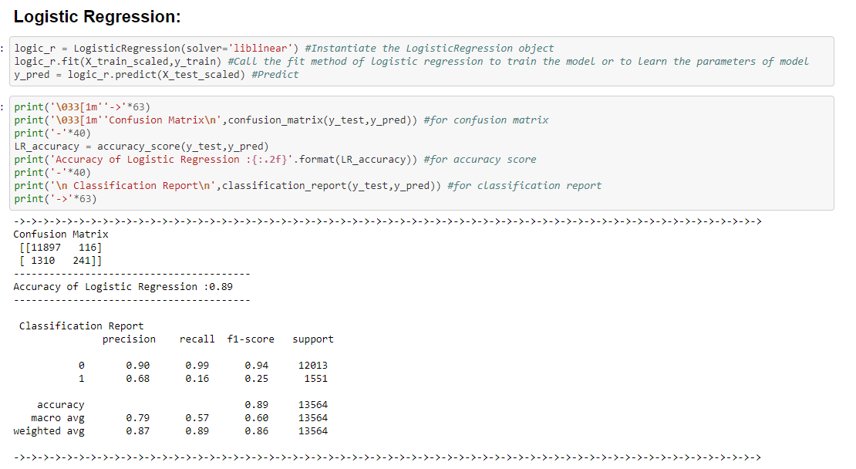

Slide 17
SUPPORT VECTOR CLASSIFIER:
Support Vector Machine or SVM is one of the most popular Supervised Learning algorithms.
The goal of the SVM algorithm is to create the best line or decision boundary that can segregate n-dimensional space into classes so that we can easily put the new data point in the correct category in the future.
This best decision boundary is called a hyperplane.
SVM chooses the extreme points/vectors that help in creating the hyperplane.
These extreme cases are called as support vectors, and hence algorithm is termed as Support Vector Machine.

Slide 18
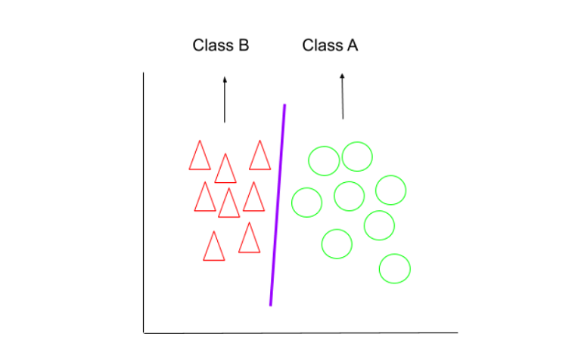
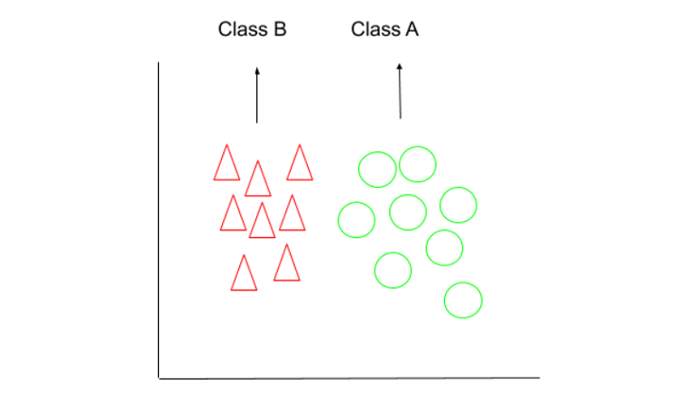
How Does SVC work?
We have two classes that are shown is the below image which are a class A: Circle & class B: Triangle. Now, we want to apply the SVM algorithm and find out the best hyperplane that divides the both

Slide 19
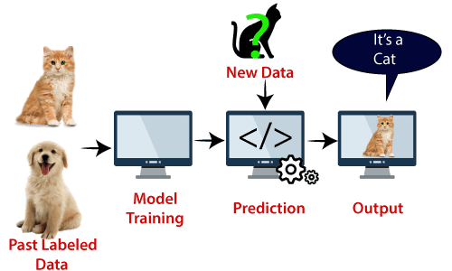
SVM algorithm can be used for Face detection, image classification, text categorization, etc.

Slide 20
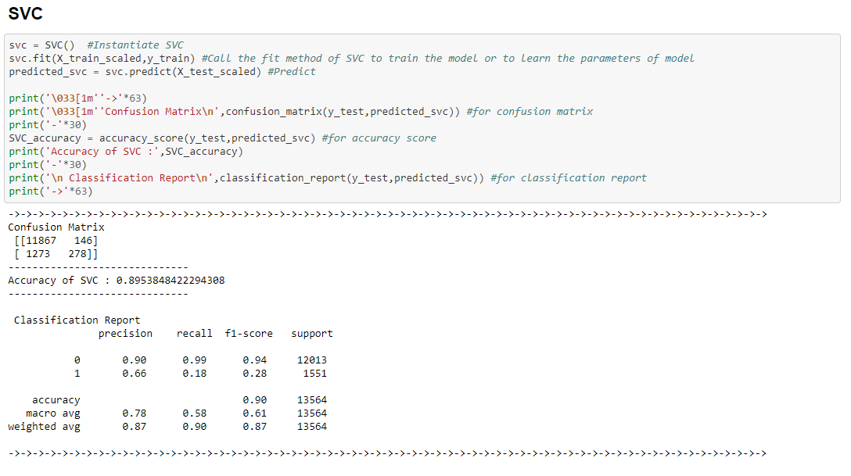

Slide 21
DECISION TREE :
Decision tree is the most powerful and popular tool for classification and prediction. Decision tree is a flowchart like tree structure, where each internal node denotes a test on an attribute, each branch represents an outcome of the test, and each leaf node (terminal node) holds a class label.
2. It is a graph in which the nodes represent an event or choice and edges of
graph represent decision rules or conditions.
3. The tree is terminated by leaf nodes that denote the result of a combination of
decisions.
4. Decision Tree is mostly used in Machine Learning and Data Mining applications using
Python.

Slide 22
5. Decision Trees are built using recursive partitioning which is also
known as divide and conquer.
6. There are various implementations of the decision trees. Well known
algorithms include C5.0 algorithm.
7. Gini Index is a metric to measure how often a randomly chosen element
would be incorrectly identified.
8. Entropy is the measure of uncertainty of a random variable, it characterizes the
impurity of an arbitrary collection of examples.

Slide 23
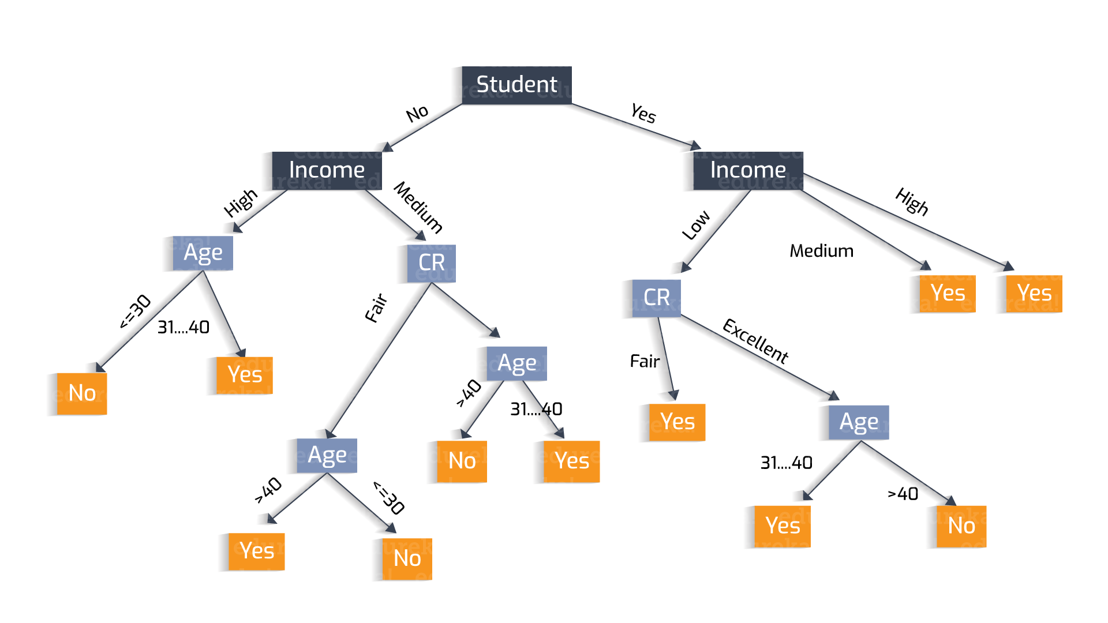

Slide 24
PRUNING OF DECISION TREE :
Pruning is a data compression technique in machine learning and search algorithm that reduces the size of decision trees by removing sections of the tree that are non-critical and redundant to classify instances.
One of the simplest forms of pruning is reduced error pruning. Starting at the leaves, each node is replaced with its most popular class. If the prediction accuracy is not affected then the change is kept.
Pruning reduces the complexity of the final classifier, and hence improves predictive accuracy by the reduction of overfitting.

Slide 25
PRUNING TECHNIQUES :
Pre-pruning : These procedures prevent a complete induction of the training set by replacing a stop () criterion in the induction algorithm (e.g. max. Tree depth or information gain (Attr)> minGain). Pre-pruning methods are considered to be more efficient because they do not induce an entire set, but rather trees remain small from the start.
Post-pruning (or just pruning): It is the most common way of simplifying trees. Here, nodes and subtrees are replaced with leaves to improve complexity. Pruning can not only significantly reduce the size but also improve the classification accuracy of unseen objects.

Slide 26
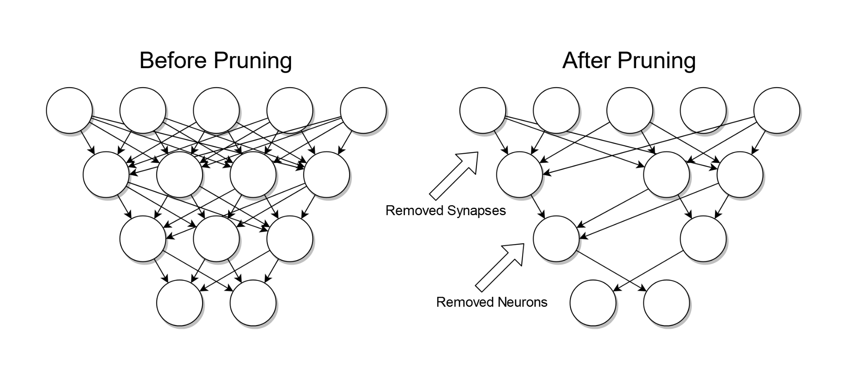

Slide 27
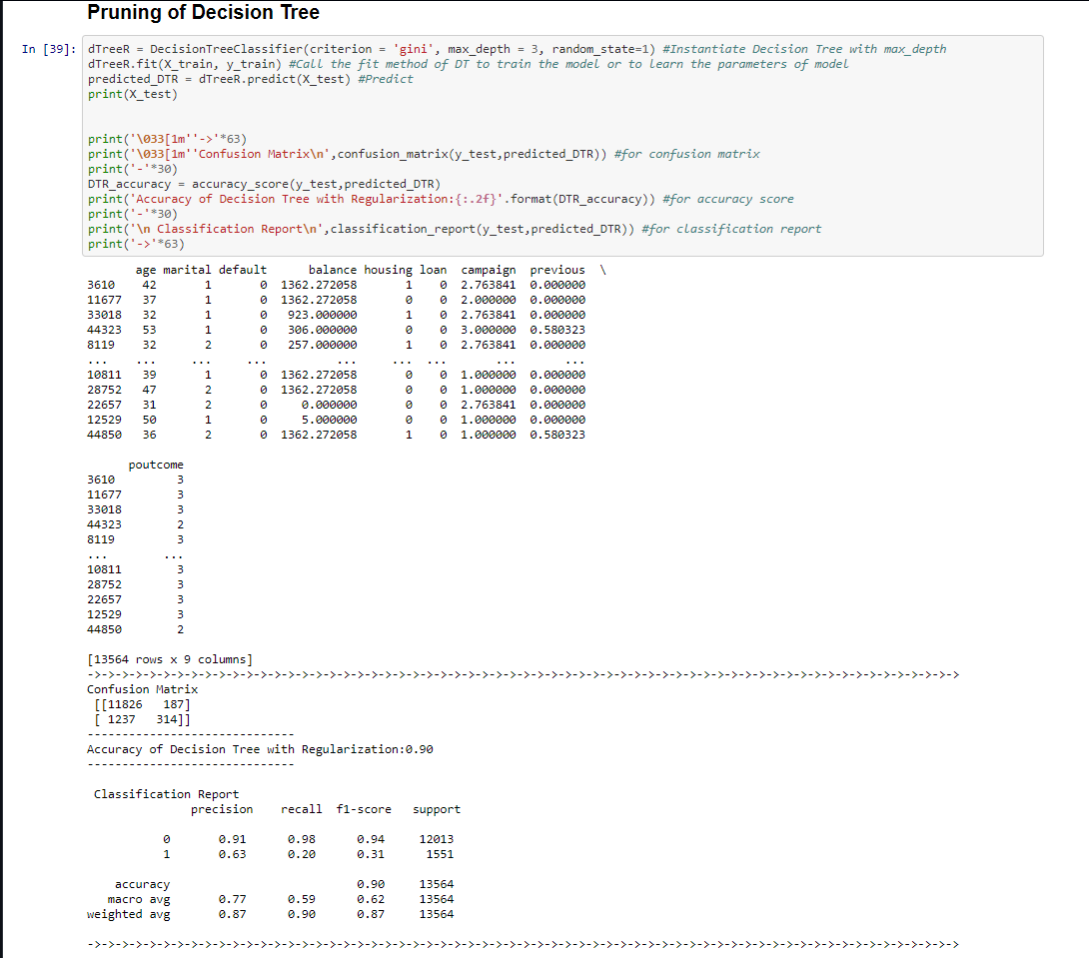

Slide 28
K-Nearest Neighbor(KNN) Algorithm
K-Nearest Neighbour is one of the simplest Machine Learning algorithms based on Supervised Learning technique.
K-NN algorithm assumes the similarity between the new case/data and available cases and put the new case into the category that is most similar to the available categories.
It is also called a lazy learner algorithm because it does not learn from the training set immediately instead it stores the dataset and at the time of classification, it performs an action on the dataset.
KNN algorithm at the training phase just stores the dataset and when it gets new data, then it classifies that data into a category that is much similar to the new data.

Slide 29
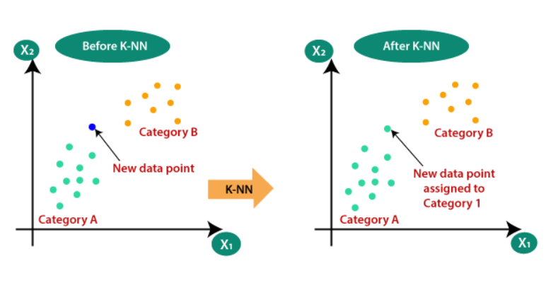
Why do we need a K-NN Algorithm?
Suppose there are two categories, i.e., Category A and Category B, and we have a new data point x1, so this data point will lie in which of these categories. To solve this type of problem, we need a K-NN algorithm. With the help of K-NN, we can easily identify the category or class of a particular dataset. Consider the below diagram:

Slide 30
How does K-NN work?
The K-NN working can be explained on the basis of the below algorithm:
Step-1: Select the number K of the neighbors
Step-2: Calculate the Euclidean distance of K number of neighbors
Step-3: Take the K nearest neighbors as per the calculated Euclidean distance.
Step-4: Among these k neighbors, count the number of the data points in each category.
Step-5: Assign the new data points to that category for which the number of the neighbor is maximum.
Step-6: Our model is ready.

Slide 31
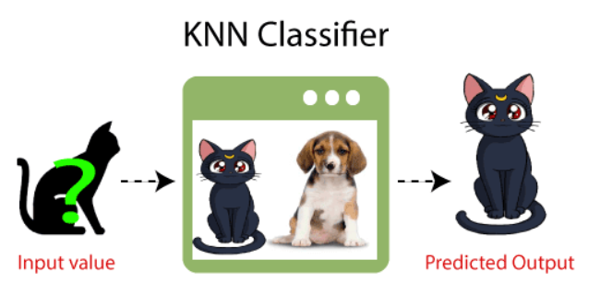
Example: Suppose, we have an image of a creature that looks similar to cat and dog, but we want to know either it is a cat or dog. So for this identification, we can use the KNN algorithm, as it works on a similarity measure. Our KNN model will find the similar features of the new data set to the cats and dogs images and based on the most similar features it will put it in either cat or dog category.

Slide 32
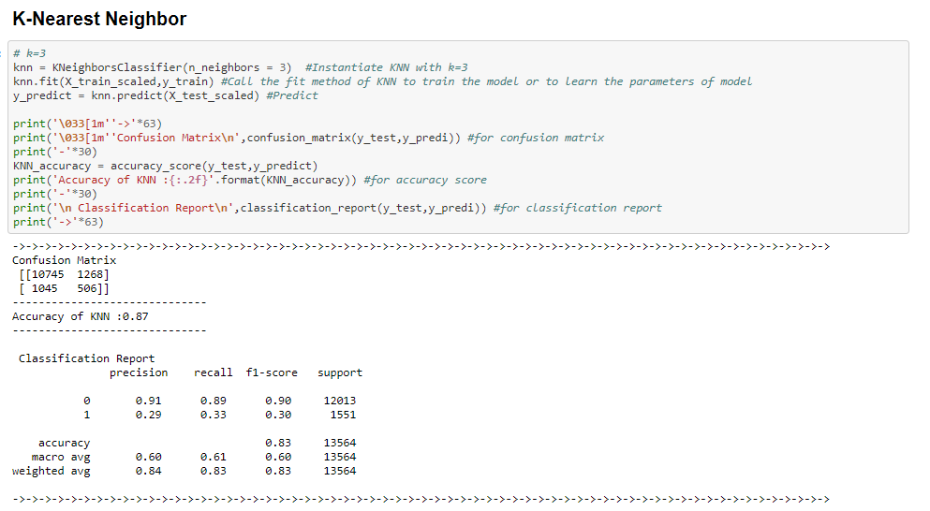

Slide 33
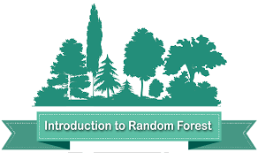
Random Forest Algorithm
Random forest (or random forests) is an ensemble classifier that consists of many decision trees and outputs the class that is the mode of the class's output by individual trees.
The term came from random decision forests that was first proposed by Tin Kam Ho of Bell Labs in 1995.
The method combines Breiman’s "bagging" idea and the random selection of features.

Slide 34
How the Random Forest Algorithm Works
The following are the basic steps involved in performing the random forest algorithm:
Pick N random records from the dataset.
Build a decision tree based on these N records.
Choose the number of trees you want in your algorithm and repeat steps 1 and 2.
In case of a regression problem, for a new record, each tree in the forest predicts a value for Y (output). The final value can be calculated by taking the average of all the values predicted by all the trees in forest. Or, in case of a classification problem, each tree in the forest predicts the category to which the new record belongs. Finally, the new record is assigned to the category that wins the majority vote.

Slide 35
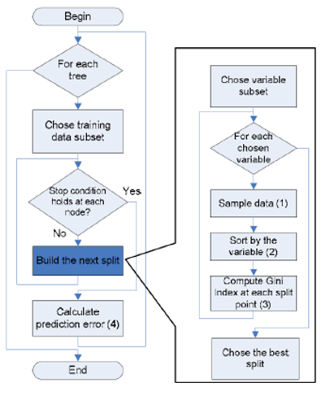
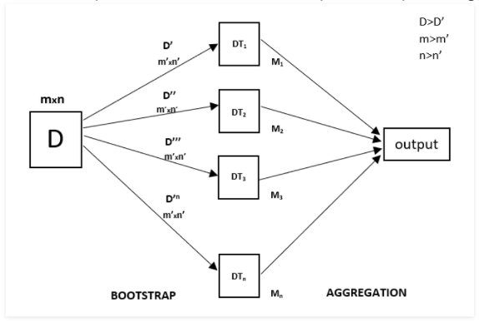
Flow chart of Random Forest Algorithm

Slide 36
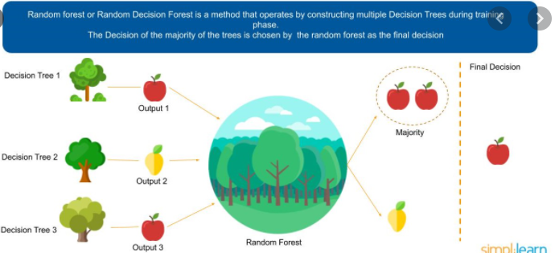
Example of Random Forest Algorithm

Slide 37
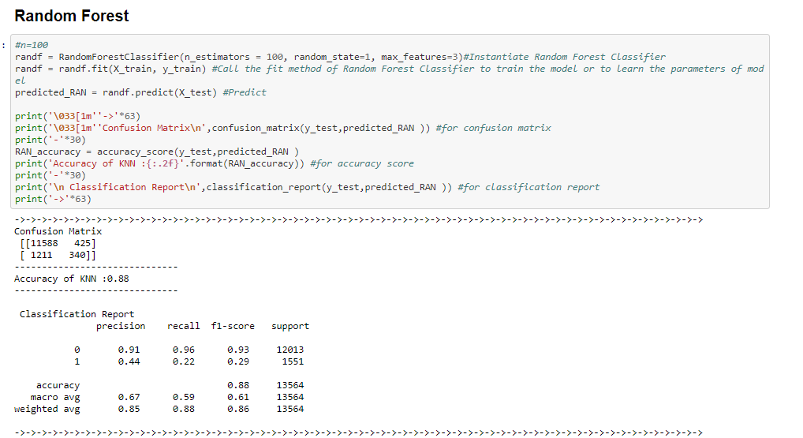

Slide 38
Implementation
We choose the best model out of the ones that we created with the best accuracy .
Then we dumped it into a pickle file .
We created a website using basic html and css .
We hosted the website using flask and used the pickle file of the model at the backend
Now when we enter the customer data in the fields on the website hosted locally we can get the output as the prediction .

Slide 39
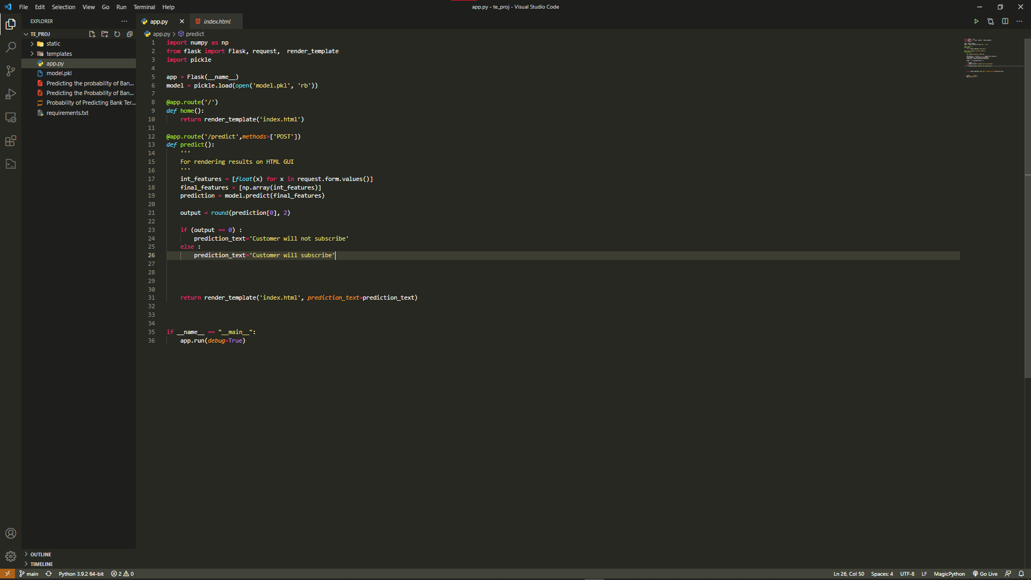

Slide 40
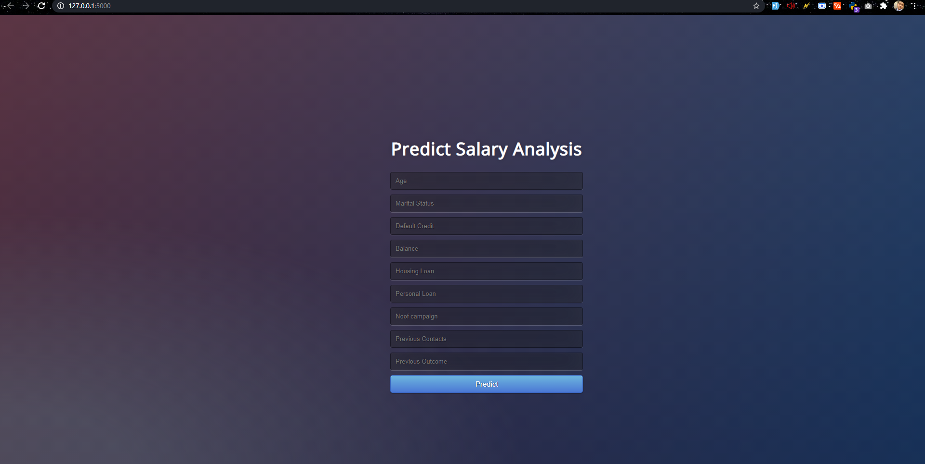

Slide 41
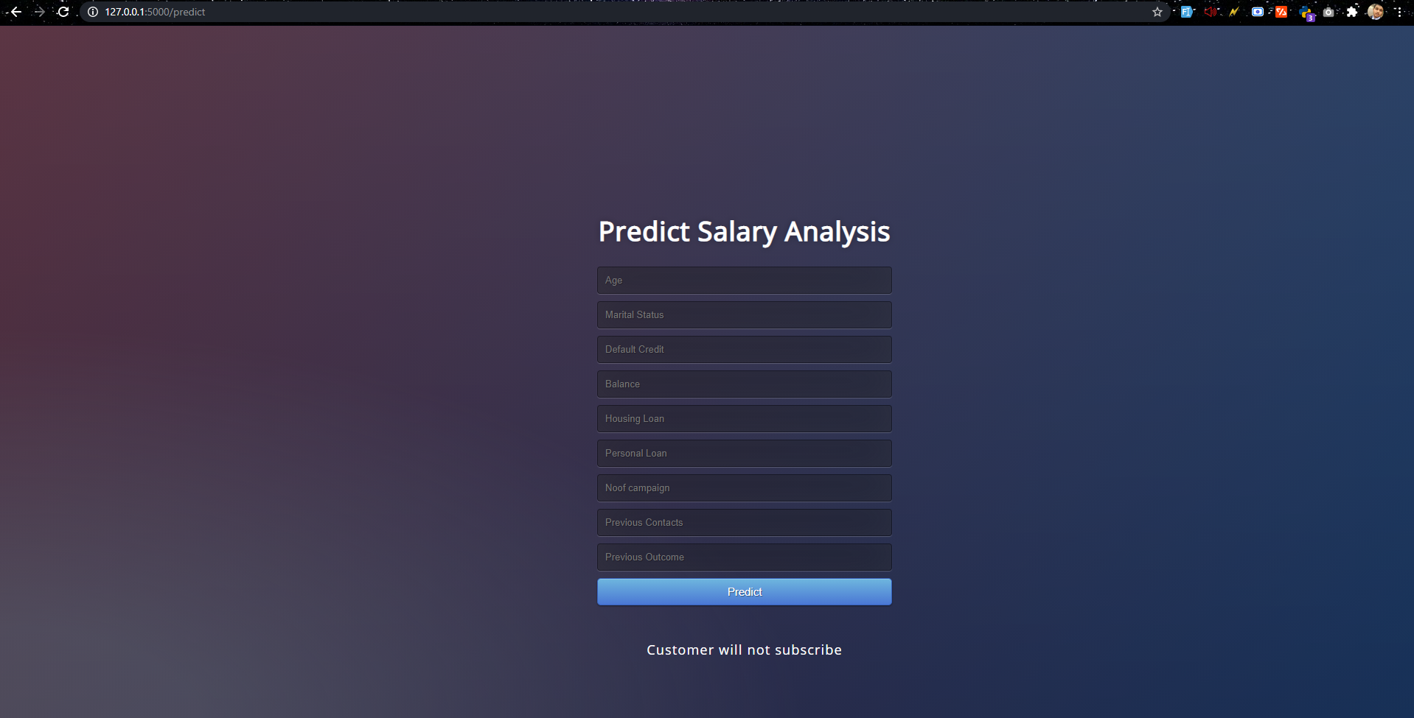

Slide 42
Conclusion
We had a lot error and problems in the data .
We had to clean the data to get the most out of the it and get the highest accuracy .
We in the came to conclusion to use Decision Tree classifier and predict the if one person will subscribe to it or not.

Slide 43
Thank You

